Slide 1
Chapter 7:
Software Engineering
Computer Science: An Overview
Eleventh Edition
by
J. Glenn Brookshear

Slide 2
Chapter 7: Software Engineering
7.1 The Software Engineering Discipline
7.2 The Software Life Cycle
7.3 Software Engineering Methodologies
7.4 Modularity
7.5 Tools of the Trade
7.6 Testing
7.7 Documentation
7.8 Software Ownership and Liability
0-<number>

Slide 3
The Software Engineering Discipline
Distinct from other engineering fields
  Prefabricated components
  Metrics
Practitioners versus Theoreticians
Professional Organizations: ACM, IEEE, etc.
  Codes of professional ethics
  Standards
0-<number>

Slide 4
Computer Aided Software Engineering (CASE) tools
Project planning
Project management
Documentation
Prototyping and simulation
Interface design
Programming
0-<number>

Slide 5
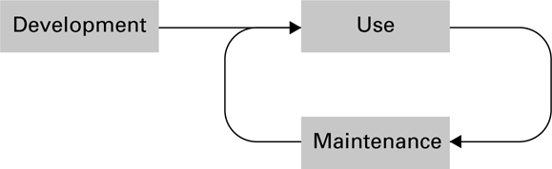
Figure 7.1 The software life cycle
0-<number>

Slide 6
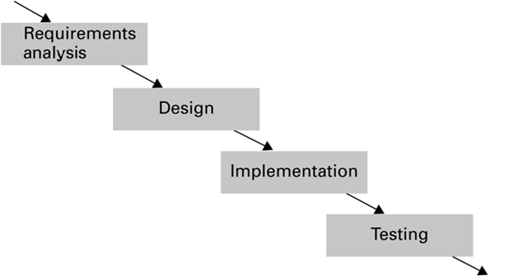
Figure 7.2 The development phase of the software life cycle
0-<number>

Slide 7
Analysis Stage
Requirements
  Application oriented
Specifications
  Technically oriented
Software requirements document
0-<number>

Slide 8
Design Stage
Methodologies and tools (discussed later)
Human interface (psychology and ergonomics)
0-<number>

Slide 9
Implementation Stage
Create system from design
  Write programs
  Create data files
  Develop databases
Role of “software analyst” versus “programmer”
0-<number>

Slide 10
Testing Stage
Validation testing
  Confirm that system meets specifications
Defect testing
  Find bugs
0-<number>

Slide 11
Software Engineering Methodologies
Waterfall Model
Incremental Model
  Prototyping (Evolutionary vs. Throwaway)
Open-source Development
Extreme Programming
0-<number>

Slide 12
Modularity
Procedures -- Imperative paradigm
  Structure charts
Objects -- Object-oriented paradigm
  Collaboration diagrams
Components -- Component architecture
0-<number>

Slide 13
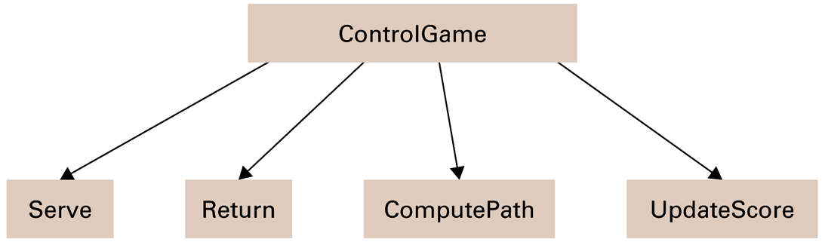
Figure 7.3 A simple structure chart
0-<number>

Slide 14
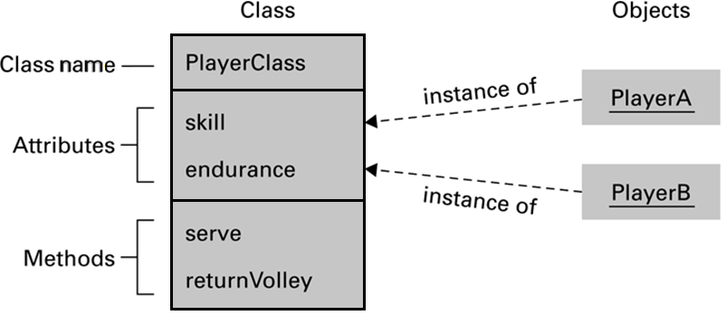
Figure 7.4 The structure of PlayerClass and its instances
0-<number>

Slide 15
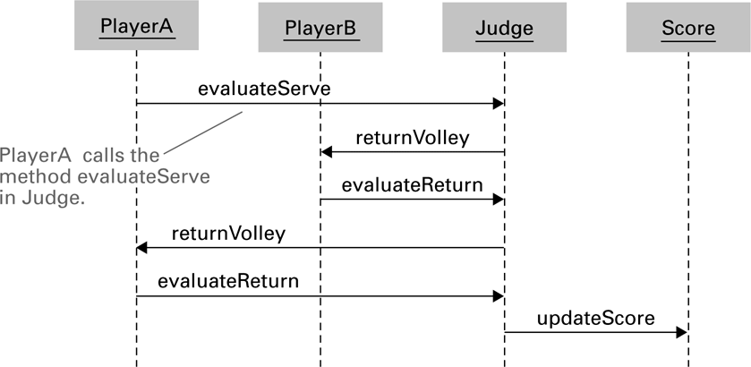
Figure 7.5 The interaction between objects resulting from PlayerA’s serve
0-<number>

Slide 16
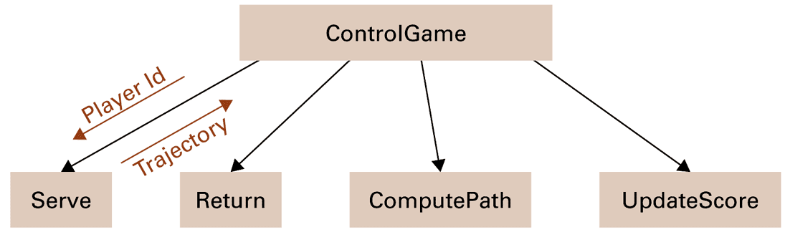
Figure 7.6 A structure chart including data coupling
0-<number>

Slide 17
Coupling versus Cohesion
Coupling
  Control coupling
  Data coupling
Cohesion
  Logical cohesion
  Functional cohesion
0-<number>

Slide 18
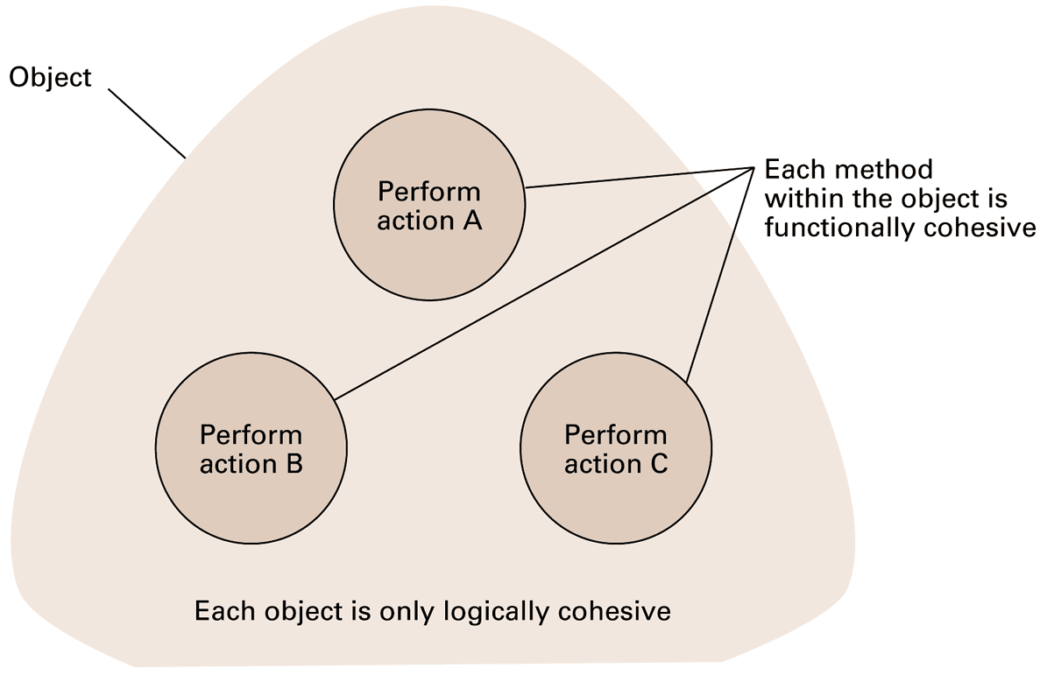
Figure 7.7 Logical and functional cohesion within an object
0-<number>

Slide 19
Tools of the Trade
Data Flow Diagram
Entity-Relationship Diagram
  One-to-one relation
  One-to-many relation
  Many-to-many relation
Data Dictionary
0-<number>

Slide 20
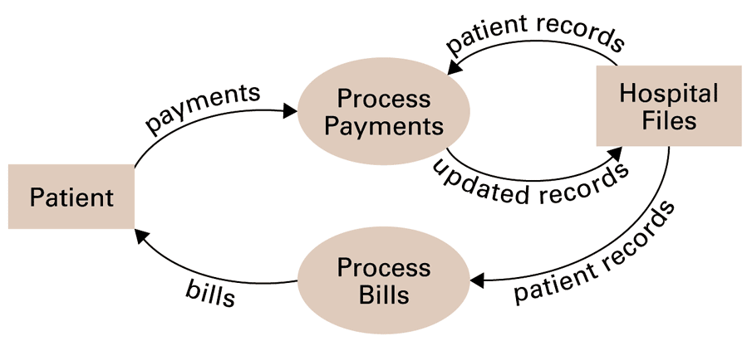
Figure 7.8 A simple dataflow diagram
0-<number>

Slide 21
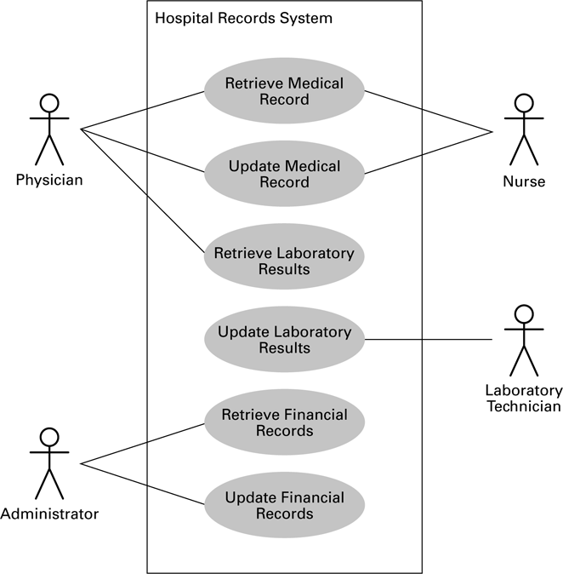
Figure 7.9 A simple use case diagram
0-<number>

Slide 22
Figure 7.10 A simple class diagram
0-<number>

Slide 23
Unified Modeling Language
Use Case Diagram
  Use cases
  Actors
Class Diagram
0-<number>

Slide 24
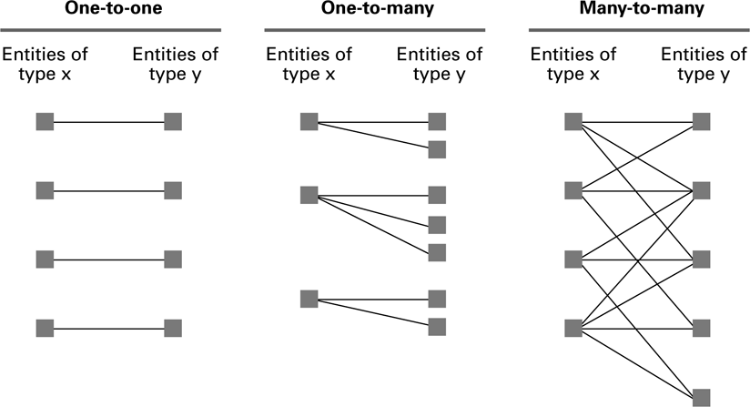
Figure 7.11 One-to-one, one-to-many, and many-to-many relationships between entities of types X and Y
0-<number>

Slide 25
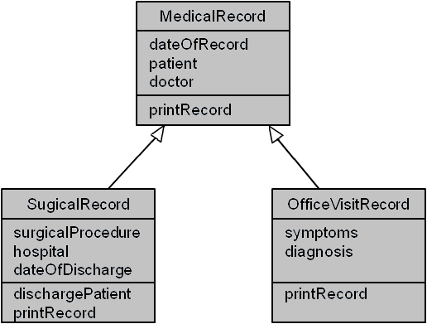
Figure 7.12 A class diagram depicting generalizations
0-<number>

Slide 26
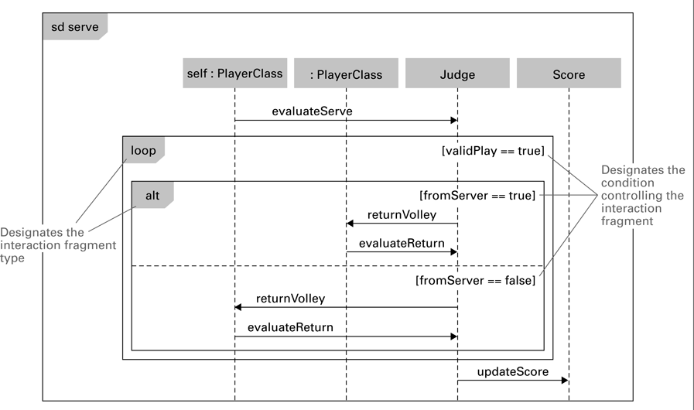
Figure 7.13 A sequence diagram depicting a generic volley
0-<number>

Slide 27
Structured Walkthoughs
“Theatrical” experiment
Class-responsibility-collaboration cards
0-<number>

Slide 28
Design Patterns
Well designed “templates” for solving recurring problems
Examples:
  Adapter pattern: Used to adapter a module’s interface to current needs
  Decorator pattern: Used to control the complexity involved when many different combinations of the same activities are required
Inspired by the work of Christopher Alexander in architecture
0-<number>

Slide 29
Software Testing Strategies
Glass-box testing
  Pareto principle
  Basis path testing
Black-box testing
  Boundary value analysis
  Redundancy testing
  Beta testing
0-<number>

Slide 30
Documentation
User Documentation
  Printed book for all customers
  On-line help modules
System Documentation
  Source code
  Design documents
Technical Documentation
  For installing, customizing, updating, etc.
0-<number>

Slide 31
Software Ownership
Copyright
  Allow a product to be released while retaining ownership of intellectual property
  Asserted in all works:
    Specifications
    Source code
    Final product
0-<number>

Slide 32
Software Ownership (continued)
Software License
  A legal agreement that grants the user certain permissions without transferring ownership
Patents
  Must demonstrate that it is new, usable, and not obvious to others with similar backgrounds
  Process is expensive and time-consuming
0-<number>

